Slide 1
Service User Guide
New Diplomatic, Consular, International Organization or Special ID Card Issuance

Slide 2
Modify Data on a Diplomatic, Consular, International Organizations or Special ID Card

Slide 3
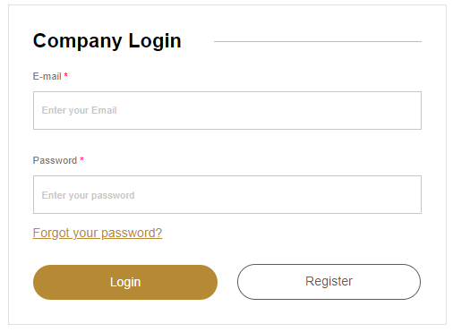
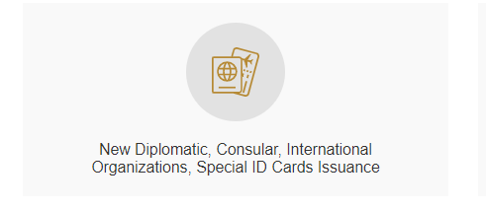
Log in using the Mission’s registered email address
Select “New Diplomatic, Consular, International Organizations, Special ID Cards Issuance” from the service options

Slide 4
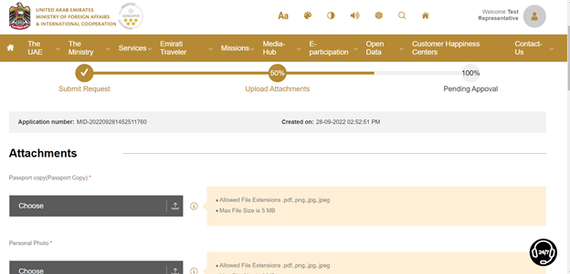
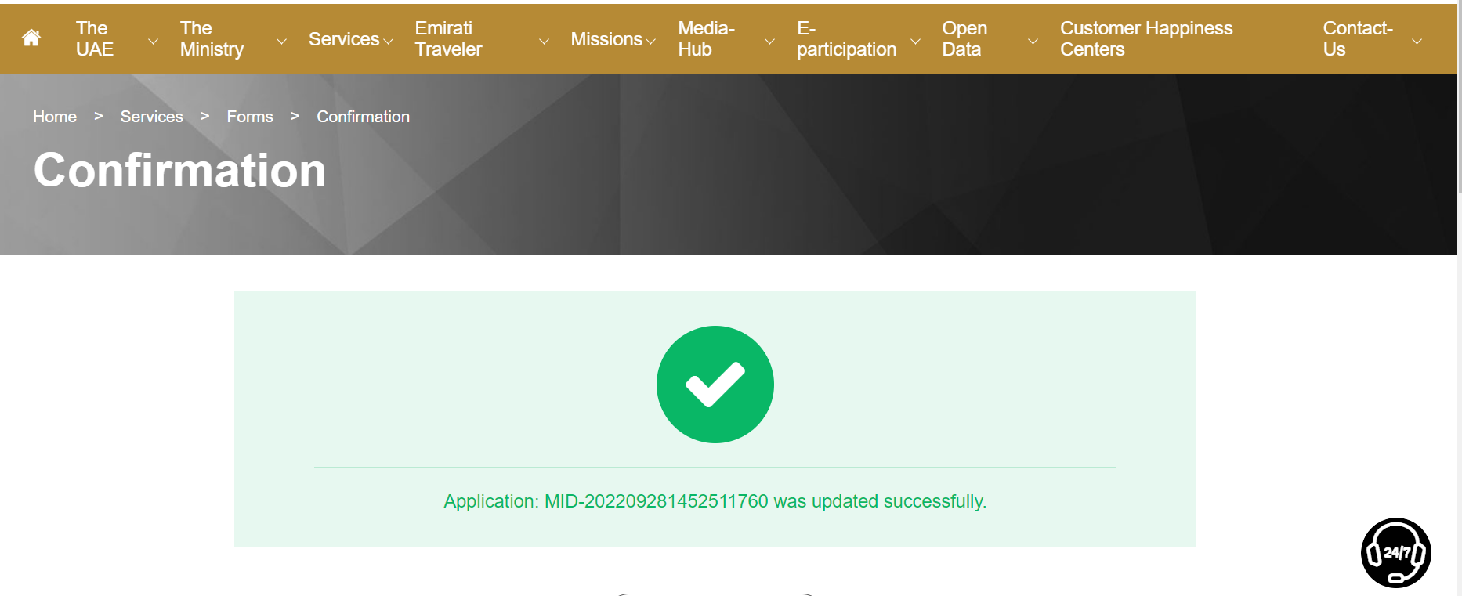
Fill the form and upload the required documents
Send the request. You will receive a confirmation message.

Slide 5
The Mission will receive an email when the ID card is ready. The card will be mailed to the Mission.
E-mail notification
Dear Customer,
Thank you for using MoFAIC’s e-services.
Your request to “Issue a Diplomatic ID Card” has been approved.
The reference number for this request is: DIPIDNEW/09082022/00001775
For enquiries: please contact MoFAIC’s Call Centre on 80044444.
عزيزنا المتعامل/ أحمد محمد
نشكركم على استخدام الخدمات الإلكترونية لوزارة الخارجية والتعاون الدولي. تمت الموافقة على طلب "إصدار بطاقة دبلوماسية”.
الرقم المرجعي لطلبكم
DIPIDNEW/09082022/00001775
للاستفسارات: يمكنكم التواصل مع مركز الاتصال عبر الرقم 80044444
SMS notification
Dear Customer, your request has been approved.
Reference number:
DIPIDNEW/09082022/00001775
عزيزنا المتعامل، تمت الموافقة طلبكم رقم DIPIDNEW/09082022/00001775

